Slide 1
Health services and athletics
Family Townhall

Slide 2
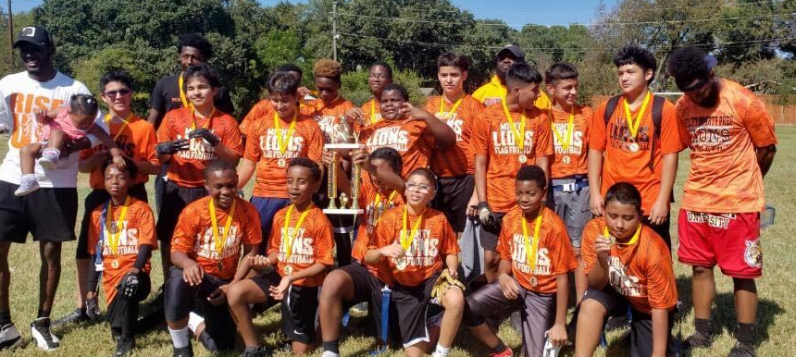
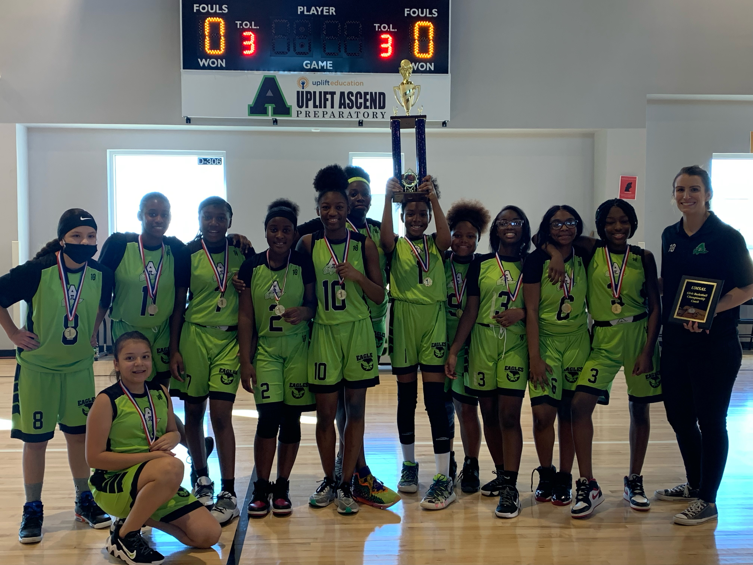
Uplift Athletics
High School Athletics – Grades 9-12
University Interscholastic League (UIL) – Hampton, North Hills, Summit, Williams
Texas Charter School Academic & Athletic League (TCSAAL) – Ascend, Atlas, Elevate, Grand, Heights, Infinity, Luna, Mighty, Wisdom
Middle School Athletics – Grades 6-8
Uplift middle schools compete in our own inter-district middle school league
Uplift Middle School Athletic League (UMSAL)

Slide 3

Uplift Athletics
www.RankOneSport.com
Athlete participation paperwork is completed online for all Uplift scholars MS & HS
Complete physical
Sign all electronic forms
Medical History
All scholars must have a physical, medical history, and all electronic forms completed prior to participating in a try-out, practice, or event.
Teams practice after school 2-3 times a week and play games twice a week on weekday evenings. UMSAL has championship tournament games that are played on Saturdays
Fall sports
Volleyball
Cross Country (XC) ***
Flag Football
Cheerleading ***
Spring sports
Basketball
Soccer
Track & Field
Baseball ***
****Each Uplift campus has different sport offerings – Contact your campus Athletic Coordinator to ask campus specific questions. (list on next slide)

Slide 4
Uplift Athletics
Philip Gomez - Uplift Athletic Director – pgomez@uplifteducation.org
Atlas
HS- Brian McGowan - bmcgowan@uplifteducation.org
MS- Madison Davis - mdavis@uplifteducation.org
Ascend
HS- Brahzetta Henry - bhenry@uplifteducation.org
MS- Keerstin Love - klove@uplifteducation.org
Hampton
HS- Chelsea Bell - cbell@uplifteducation.org
MS- Ryan Range - rrange@uplifteducation.org
Elevate
HS- Omar Chavira - ochavira@uplifteducation.org
MS- Omar Chavira - ochavira@uplifteducation.org
Heights
HS- Keviyon Manuel - kmanuel@uplifteducation.org
MS- Shateek Nasir - snasir@uplifteducation.org
Grand
HS- Adam McCoy - amccoy@uplifteducation.org
MS- Denae Swan - dswan@uplifteducation.org
Infinity
HS- Colton Silvia - CSilvia@uplifteducation.org
MS- Matthew Price - mprice@uplifteducation.org
Luna
HS- Devodrick Ross – Dross@uplifteducation.org
MS- Esra Jackson - EsJackson@uplifteducation.org
Mighty
HS- Richard Young - Riyoung@uplifteducation.org
MS- Adriane Davis - Addavis@uplifteducation.org
Summit
HS- Renita Davidson - rdavidson@uplifteducation.org
MS- Sherona Edwards - sedwards@uplifteducation.org
Williams
HS- Taylor Walker - tawalker@uplifteducation.org
MS- Alyessa Soden - asoden@uplifteducation.org
Wisdom
HS- Ashleigh Franklin - asfranklin@uplifteducation.org
MS- Katherine Golden - kgolden@uplifteducation.org
North Hills
HS- Kennith Gober - kgober@uplifteducation.org
MS- Mireda Rubayo - mrubayo@uplifteducation.org

Slide 5
Uplift Health services
Our Commitment
To provide a healthy environment in which our students can learn and thrive.
To comply with all state and local health orders, mandates, and guidelines in order to ensure the health and safety of all individuals on campus.
Uplift Education encourages all staff and age-eligible students to get vaccinated.
Masks are strongly recommended but not required. However, Uplift reserves the right to more restrictive mask wearing guidance if metrics change beyond the school site or district’s capacity to ensure safety

Slide 6
uplift Health services
                TO ENSURE SCHOLARS HEALTH AND SAFETY
Promote routine, frequent and proper hand hygiene (soap and water or hand sanitizer) is one of the best ways to avoid spreading germs. Everyone should continue the habit of washing hands frequently at home and at school.
Schools will continue to teach and reinforce washing hands throughout the school day, as well as hygienic practices such as avoiding contact with one's eyes, nose, and mouth, and covering coughs and sneezes among students and staff.
Handwashing stations are situated in various locations on campus and hand sanitizer is available in all classrooms.
Custodial staff will continue regular cleaning of school sites. Cleaning involves wiping down high-touch surfaces to remove surface contaminants.
In the event of a confirmed case of illness, custodial staff will use high-grade sprayers with a sanitizing product that is EPA approved for use against COVID-19 within 24 hours.
Staff and classrooms have access to paper towels and spray bottles of a cleaning solution to wipe down any shared surfaces.

Slide 7
PROGRAMS OFFERED THROUGH UPLIFT health services
Flu clinics
COVID Testing
COVID Vaccine Clinics
Telehealth Visits on Campuses
Vision/Hearing/Scoliosis screening

Slide 8
Questions???
LaTonja Heath, MSN, BSN, RN
Director of Health Services
Cell:469-704-8464

